Slide 1
ONLINE DOCTOR APPOINTMENT AND CONSULTATION SYSTEM

Slide 2
Team Members Contribution
Member Name
Manvitha Chowdary | UML Diagrams, Backend, Testing
Sreeja Reddy Chiligireddy | UI DESIGN, BACKEND
Vaishnavi Gawni | UI DESIGN, SCHEDULING MEETINGS,Ghantt Chart
Meghana Pentyala | UI DESIGN, Testing, UML Diagram
Vagdevi Gudapati | UI DESIGN, Documentation, PPT
Anirudh Reddy Gade | UI DESIGN, ER DIAGRAMS
Mukunda Priya | Gathering reqy=uired sources, UI design
Sai Vamsi Krishna Kadiyala | Implementing UI Design, PPT

Slide 3
Contents
Brief Introduction
Requirement Specification
Modules
Implementation
Working
Output Screenshots
Conclusion

Slide 4
BRIEF INTRODUCTION
“Online doctor appointment and consultation system” is a website which is used by doctors, patients and pharmacy. As the name suggests, in this website patient can book the doctor’s appointment online and can have a consultation. Moreover, we can also buy the medicines from this site. These medicines can be delivered to the home.

Slide 5
Requirements Specification
Functional Requirements:
The system provides a user-friendly interface for the doctors and the patients that saves time by eliminating the physical consultation which involves journey and money.
The system shall provide feature of searching the doctor and booking an appointment online with minimum efforts for the users.
The system provides online payment for booking an appointment on the website.
The website allows the user to download medicine prescription and also forward to the pharmacies to get door delivery of the medicines.

Slide 6
Requirements Specification
Non-Functional Requirements:
The services in the project should run at a reasonable speed so that the users can browse the site faster.
The interface design of the project should be clearer and easily understandable so that the users of the site can browse faster without any effort.
Users should be allowed to access the site with a strong password so cracking the password should be difficult and provides security.
The server should run 24X7 without interruption so that users can use the site at any time.
The system should show alert messages for any invalid operations performed by users.

Slide 7
Requirements Specification
Hardware requirements include an Intel i7 processor or higher and RAM 8 GB or more HD 200 GB or more
Software prerequisites are Eclipse-based IDE, Java with MySQL, Front-end HTML, CSS, and JavaScript.
Server: Tomcat by Apache e. Platform: Any web browser that is compatible, such as Firefox or Google Chrome.
Communication Interfaces are HTTP protocol which is used for internet connectivity.

Slide 8
MODULES
Administration Module
Doctor Module
Patient Module
Pharmacy Module
Apart from this, in the site also consists of about, which briefly describes about the page, and also if there are any queries from the users, they can contact the admin, using contact us module.

Slide 9
Administrator Module
Admin is an authorized person who manages data on the website. Admin verifies the profiles of doctors and activates the accounts, which makes visibility to the users. He also receives feedbacks from users and doctors and updates the website time to time.

Slide 10
Doctor Module
This module allows doctors to register on the website and after account has been activated, he/she can post consultation timings, fee details etc. Doctor after discussing with the user/patient, can post the prescription of medicines. Doctor can also view the payment detail.

Slide 11
Patient Module
User module allows the patient to register on the website and provides search for the doctors of their choice and allows to book an appointment. This module allows patient to pay consultation fee to doctor online and transaction will be completed on spot. User can download the prescription sent by doctor and the same can be forwarded to pharmacies to get medicine to their doorstep.

Slide 12
Pharmacy Module
In this module, a pharmacy registers on this website and takes order of medicines from the patient and delivers the same at the patient’s doorstep.

Slide 13
Implementation
In the front-end HTML is used. All the HTML pages will get displayed according to the code written. In the Backend NetBeans is used. NetBeans with JDK has to be installed. MYSQL has to be installed. Database setup is done through MYSQL Workbench. MYSQL workbench will get installed during the installation process of MYSQL.

Slide 14
Working
A web link is shared to everyone. On clicking it, both the user and Admin registers and logins. The user is navigated to the home page and selects the service based on the requirement. Later, he is navigated to a page where all his details like name, mobile number, address has to be entered. Now comes the role of the admin, who manages all the complaints. He sends the worker to the prescribed location. After work completion, the worker updates it to the admin and the admin updates the work status. After, the worker collects the amount from the customer. The customer later gives the review and the business growth is based on the customer.

Slide 15
Step No | Test Case | Step Description | Expected Output | Actual Output | Result
1. | Installing Eclipse | Installing Eclipse | Installed | Installed | Success
2. | Source Code Execution | Source Code Execution | Executed | Executed | Success
3. | Home Page Login | Home Page Login | Home Page Login | Home Page Login | Success
4. | Admin Login | Enter username, password | Successfully login | Successfully login | Success
5 | Doctor Registration | Enter doctor details like name, hospital name, mobile, email, password, address, state, city, timings, consultation fee | Successfully Registered | Successfully Registered | Success
6 | Doctor Login | Enter email, password correct | Successfully login | Successfully login | Success

Slide 16
7 | Patient Registration | Enter patient details like name, address mobile, email, password | Successfully Registered | Successfully Registered | Success
8 | Patient Login | Enter email, password correct | Successfully login | Successfully login | Success
9 | Search doctor | Enter symptoms or medical area. | Shows the available doctors. | Shows the available doctors. | success
10 | Book Appointment | Select doctor, enter symptoms and details. | Booked successfully | Booked successfully | success
11 | Payment Fee | Enter card details and make payment. | Booked successfully | Booked successfully | Success
12 | Add Feedback | Enter the comment and give the rating. | Submitted Feedback | Submitted Feedback. | Success
13 | View Feedback | Enter the username and password. | View feedback | View feedback | Success

Slide 17
14 | Doctor view patients | Go to Appointments. | Shows the appointments. | Shows the appointments. | Success
15. | Add Prescription | Add Prescription | Prescription added | Prescription added | success
16. | Download prescription | Download prescription | Prescription file downloaded | Prescription file downloaded | success
17. | View Prescription | View Prescription | Show s prescription in browser | Show s prescription in browser | success
18. | Patient send Prescription to pharmacy | Patient send Prescription to pharmacy | Prescription sent | Prescription sent | success
19. | Pharmacy registration | Pharmacy registration | Successful Registration | Successful Registration | success
20. | Pharmacy Login | Pharmacy Login | Login Success | Login Success | Success
21. | Pharmacy download prescription file | Pharmacy download prescription file | Prescription file downloaded | Prescription file downloaded | Success
22. | Pharmacy update dispatch status | Pharmacy update dispatch status | Dispatch success | Dispatch success | Success

Slide 18
Feedback
The feedback received is quite good since all the features promised are implemented in the project. They suggested to change the payment mode to worker from cash to online transaction. The feedback we got from them is to change the format of the field names in the patient dashboard, as we mistakenly lowercased the first letter of the field name. So, for this we have rectified the mistake and pushing the modified code in phase 2 source code.
The other suggestion they gave is to maintain a single login page for all the users instead of four different pages but what we thought is creating four different user pages would give a clear-cut idea and we can also use the images appropriately, which makes easy visual understand as well.
So, for this we are not going to make any changes.

Slide 19
Code Inspection Results
During code inspection, the opponent team verified whether all the features are included or not. They verified the correctness of the core functionalities mentioned and also verified the hardware and software requirements of the project. They also verified whether all the UML diagrams such as Use Case, Class, Sequence diagrams are correct or incorrect. After total project verification the feedback received is quite good.

Slide 20
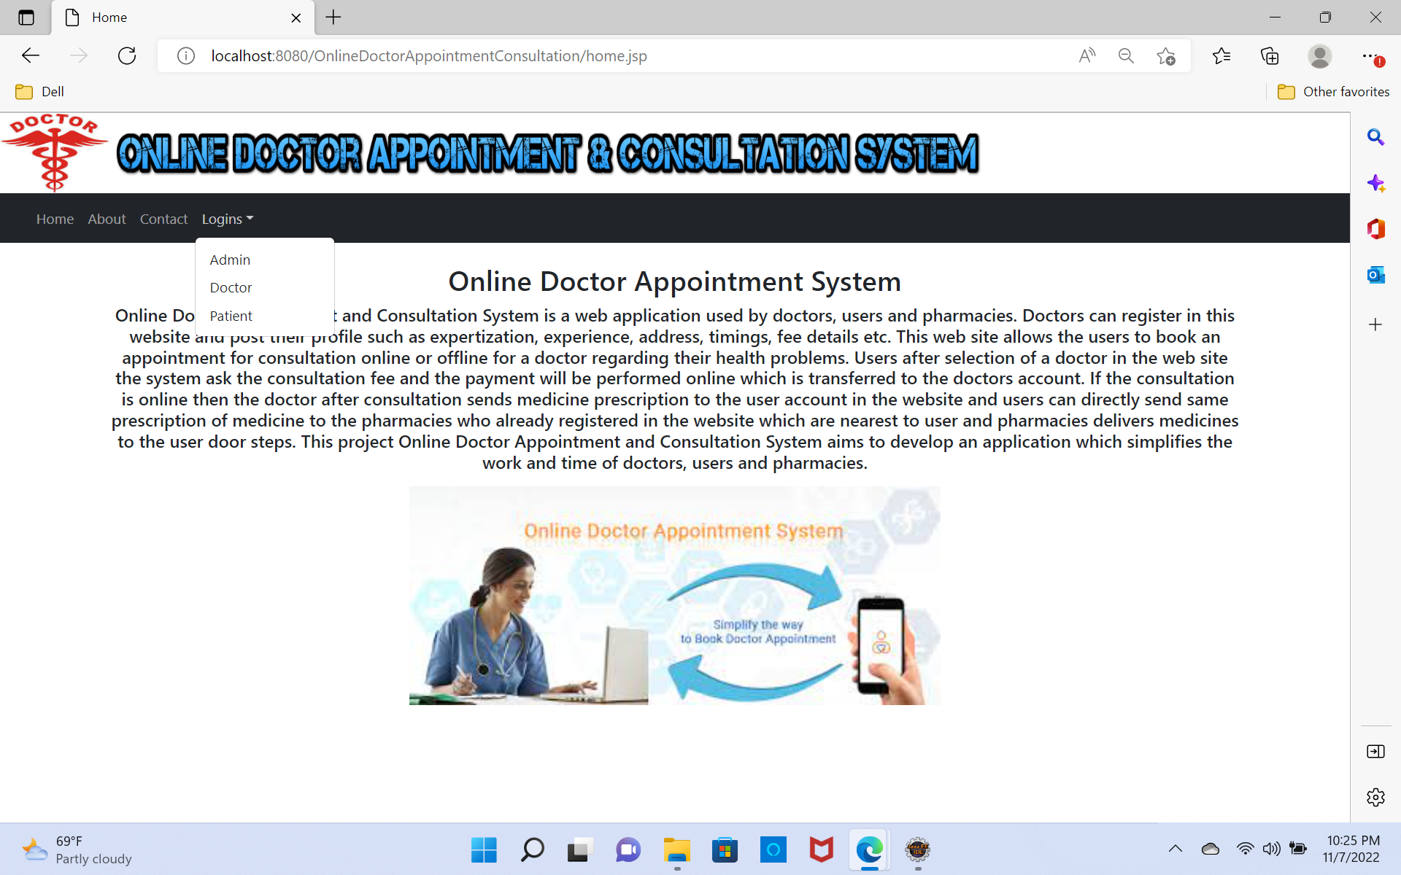

Slide 21
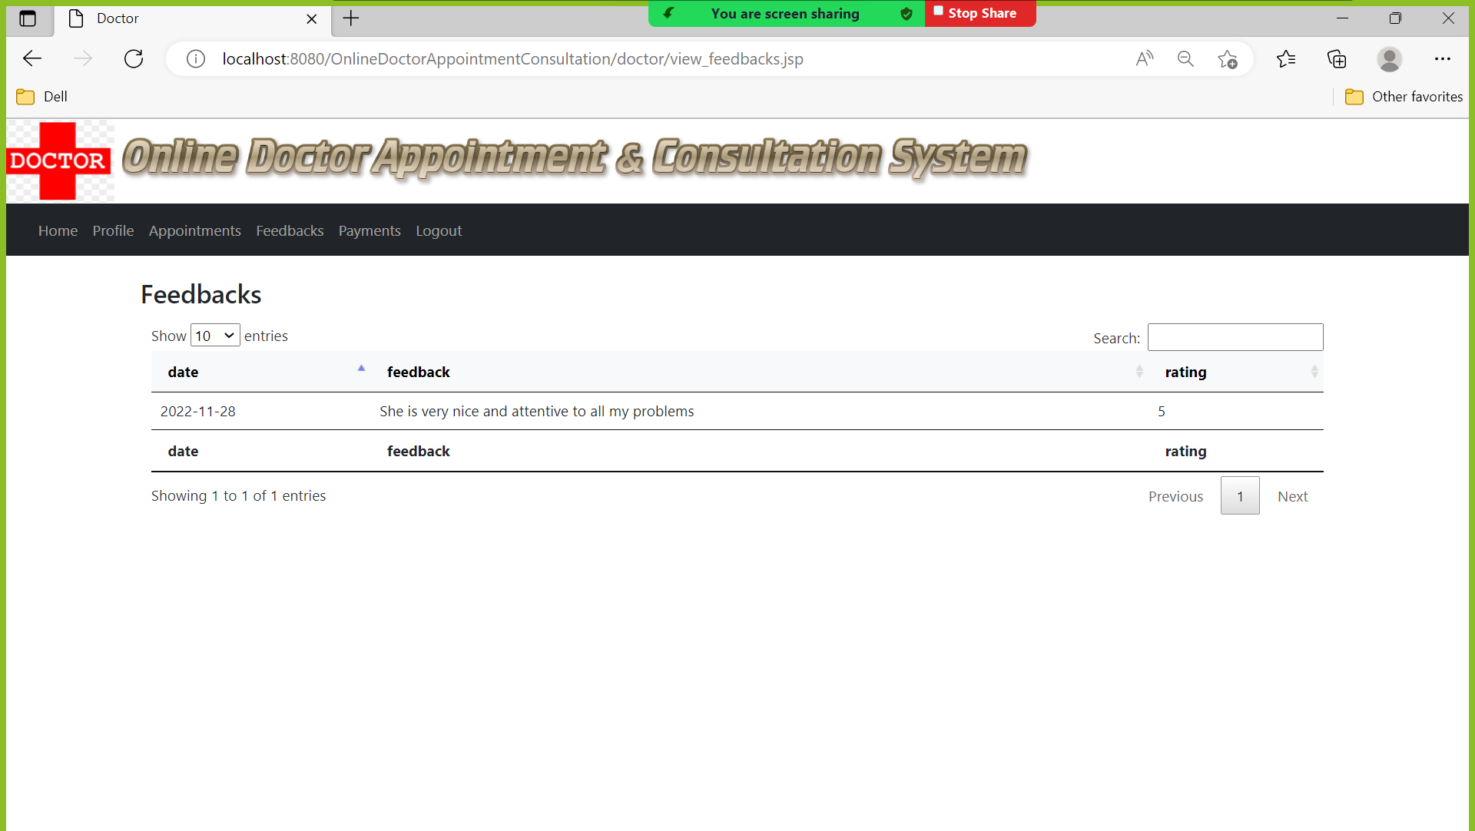
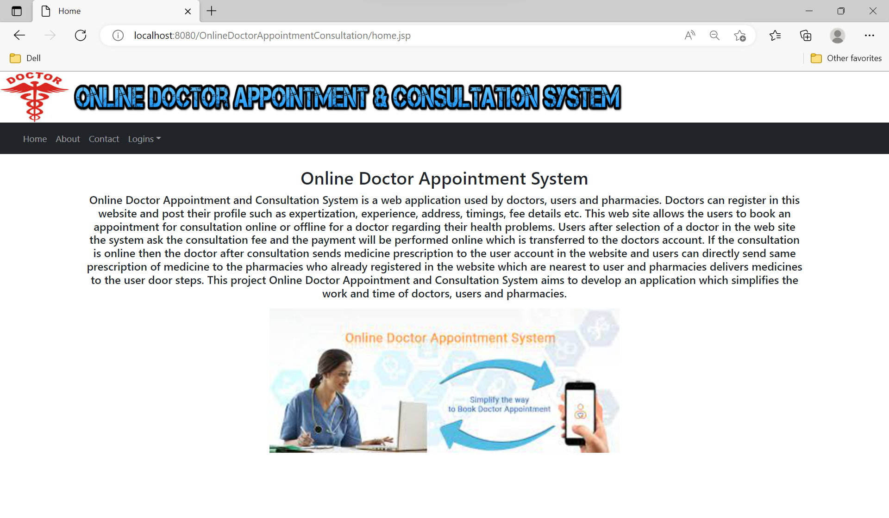
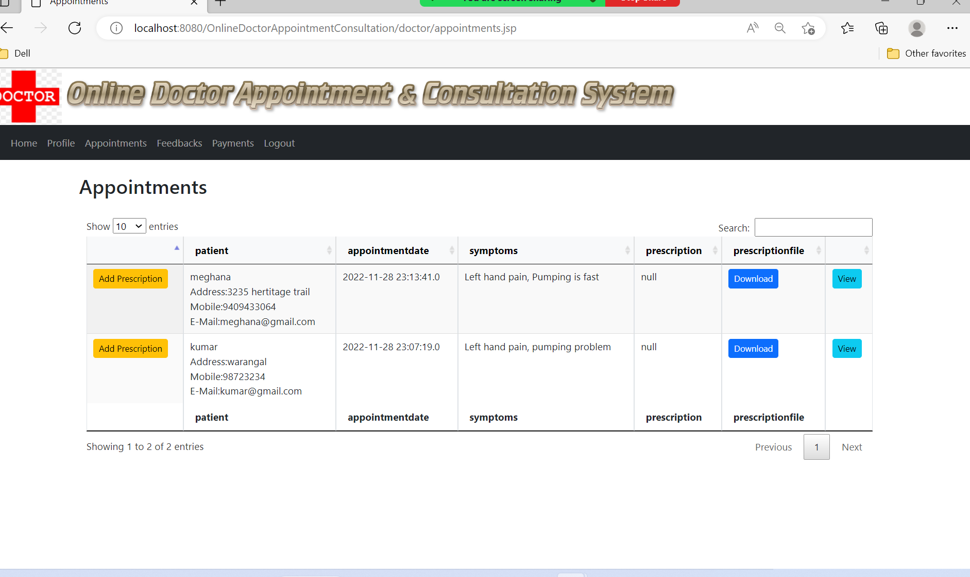
Output Screenshots

Slide 22
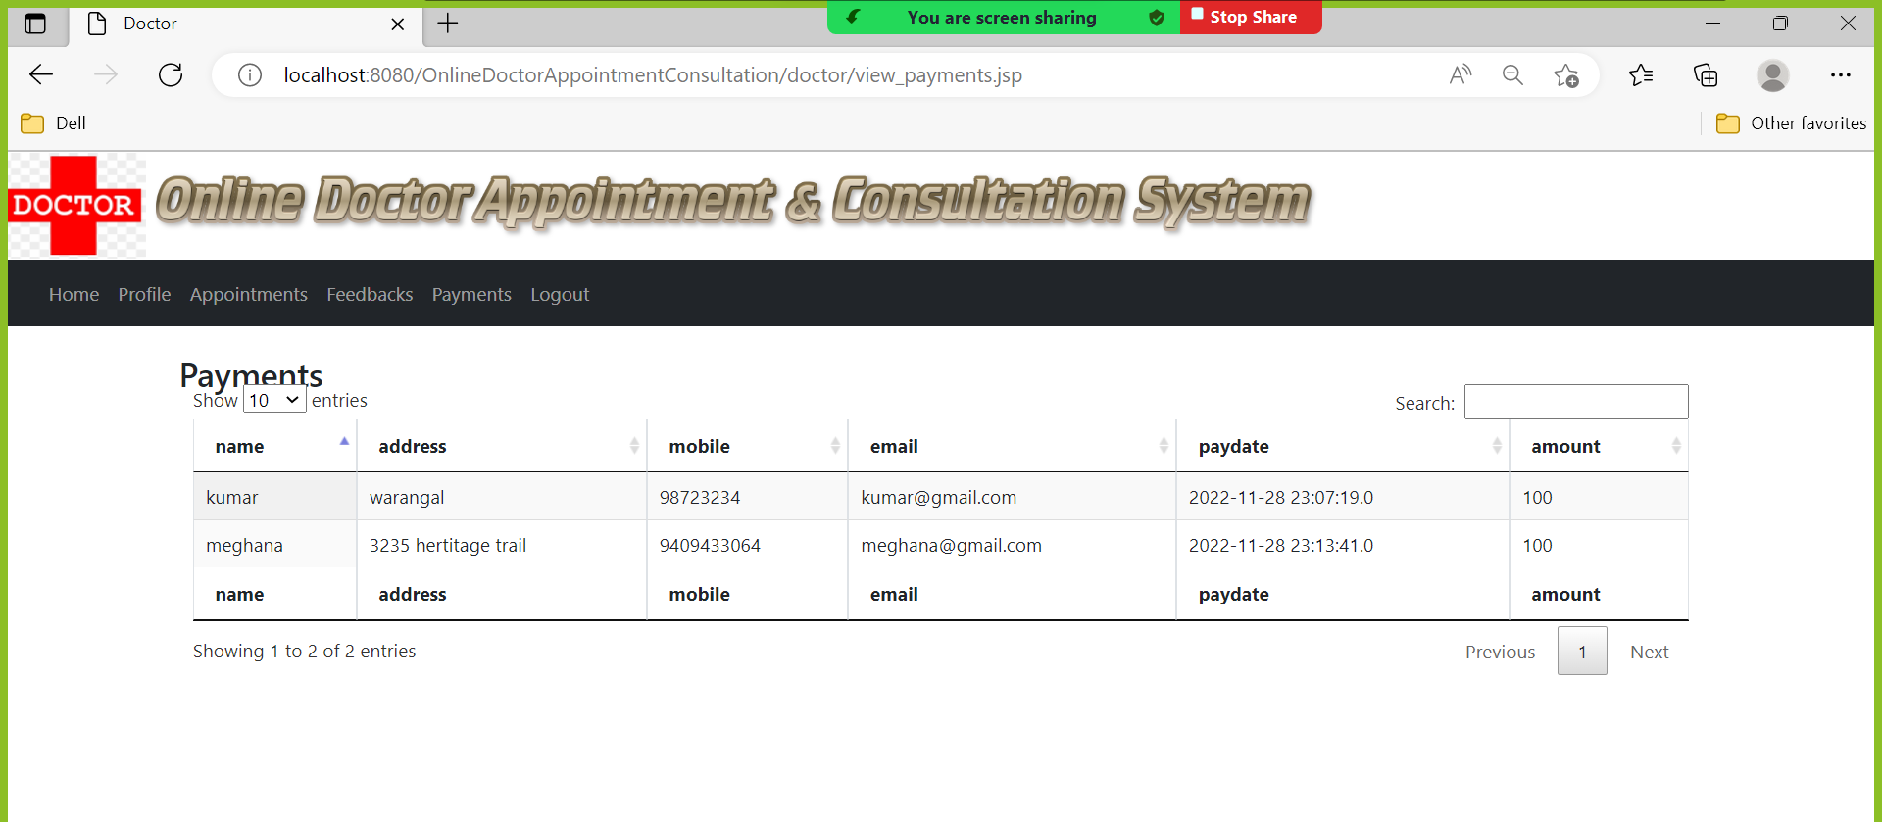

Slide 23
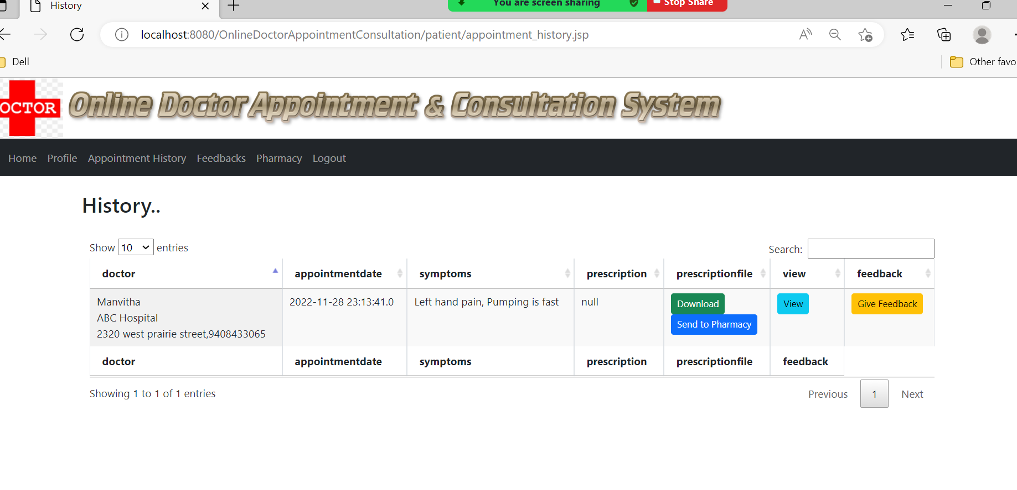

Slide 24
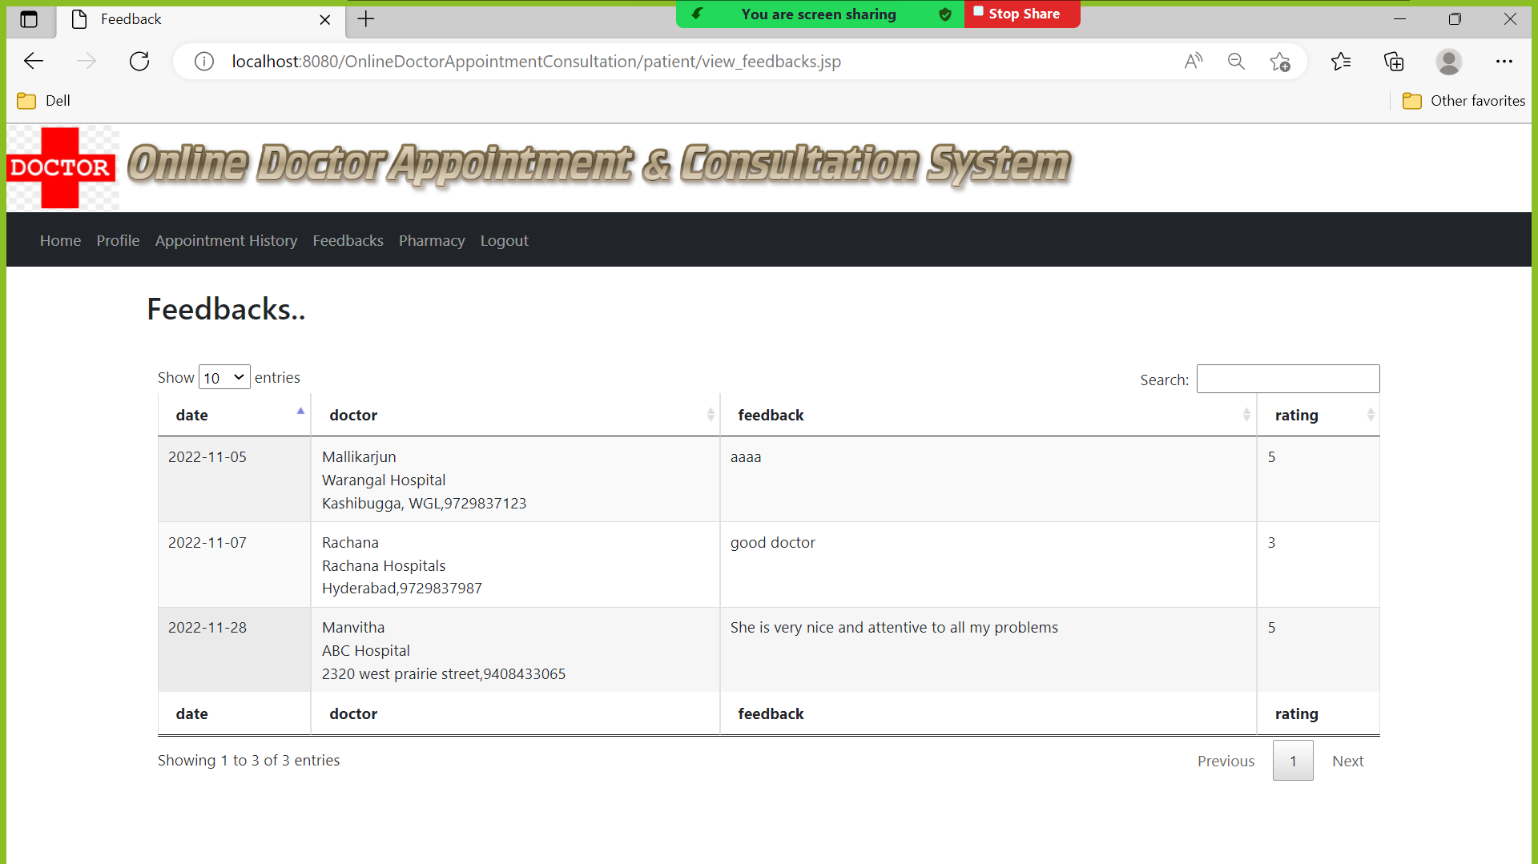

Slide 25
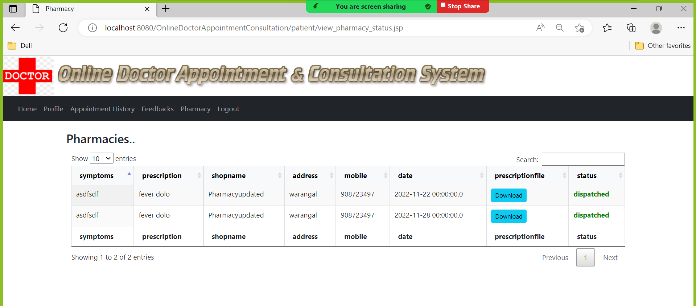

Slide 26
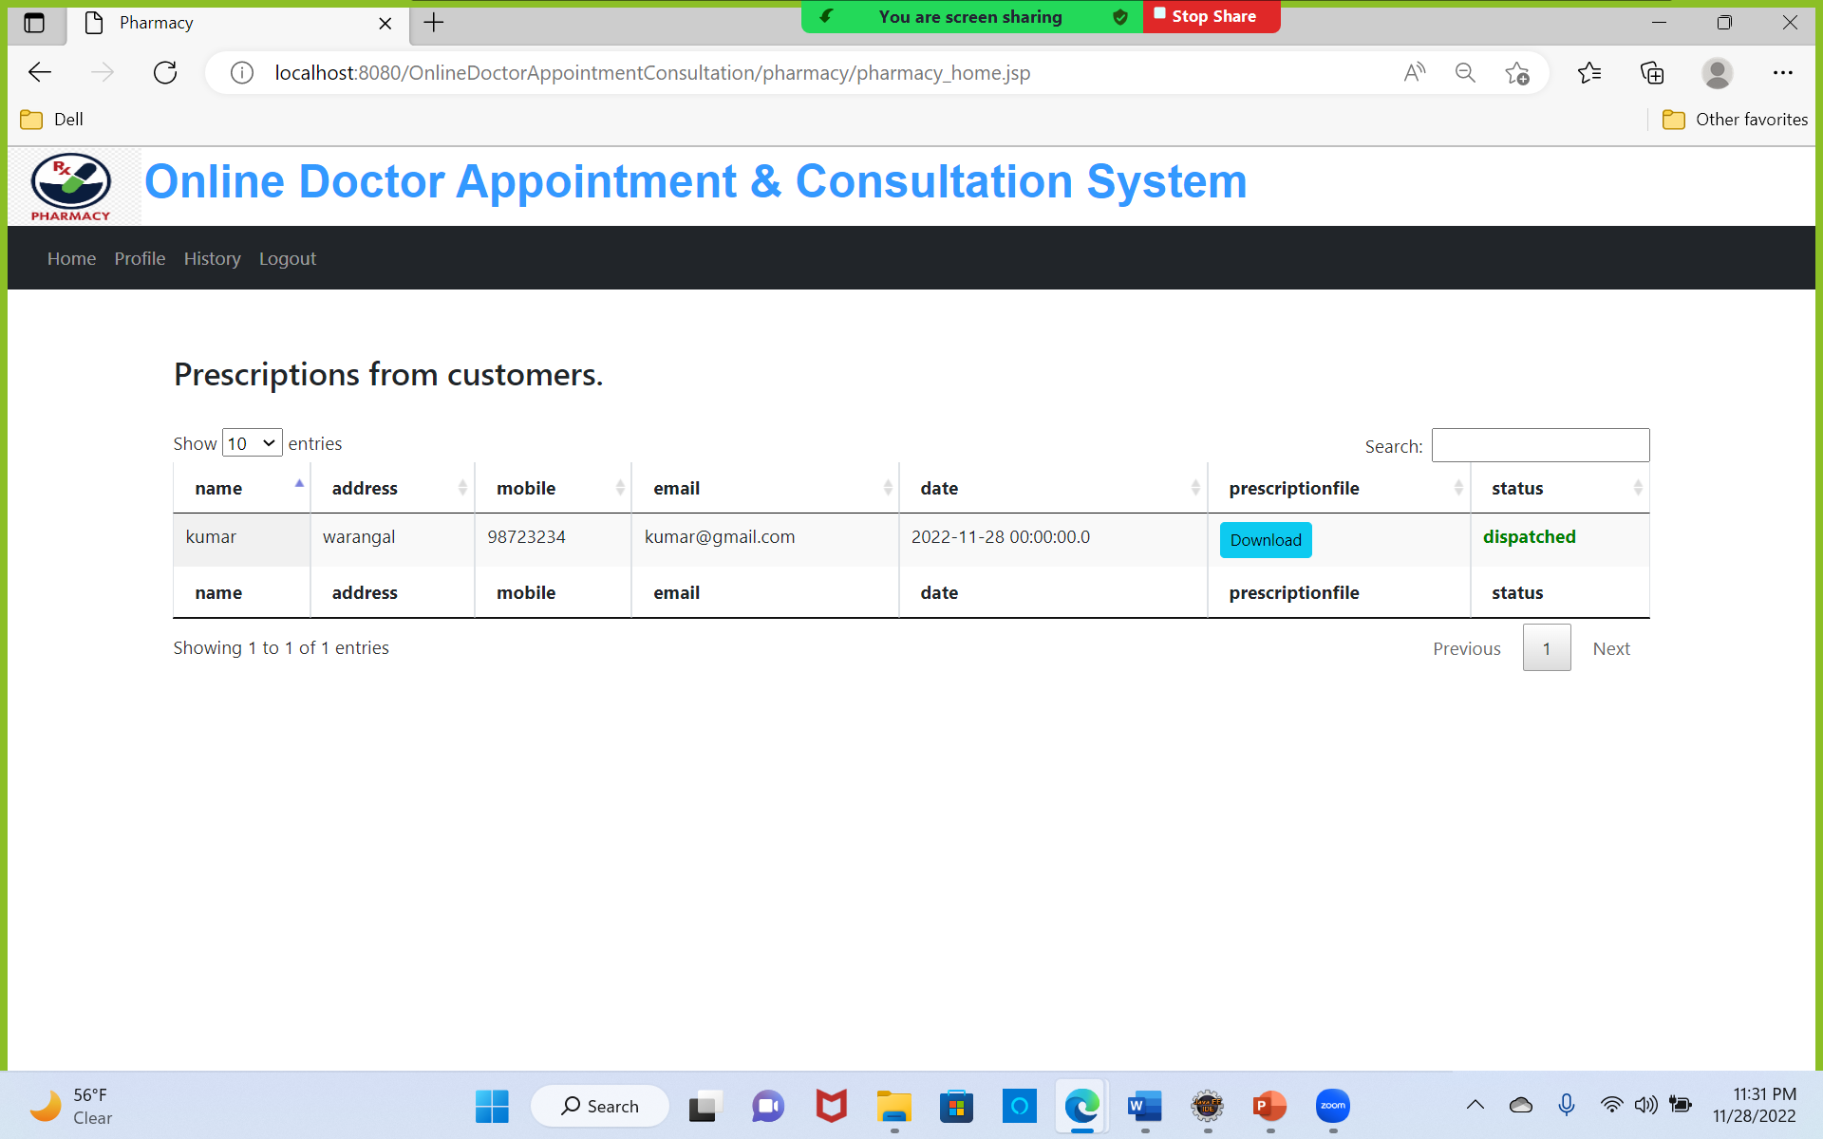

Slide 27
Conclusion
The project is successful in carrying out all the functionalities that are required. I would like to conclude that project has achieved its objective by making the common mans life easier, even though there are areas of improvement.

